Slide 1
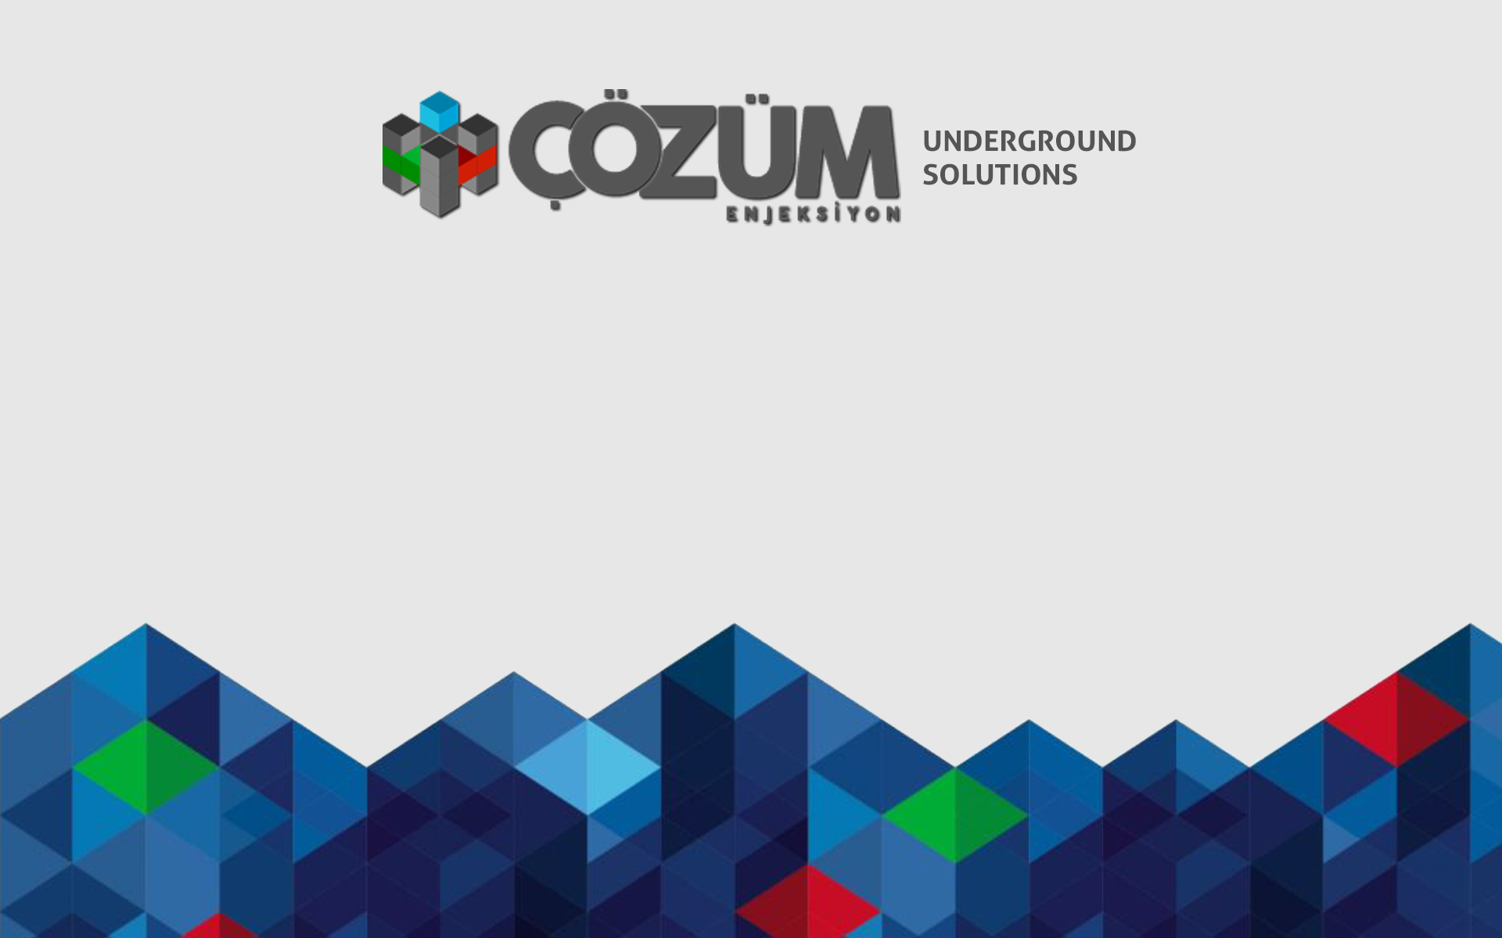
Tünelcilikte Arazi İyileştirme-Stabilizasyon Yöntemleri Ground Improvement-Stabilization Methods in Tunneling
Murat ARSLAN
Maden Mühendisi

Slide 2
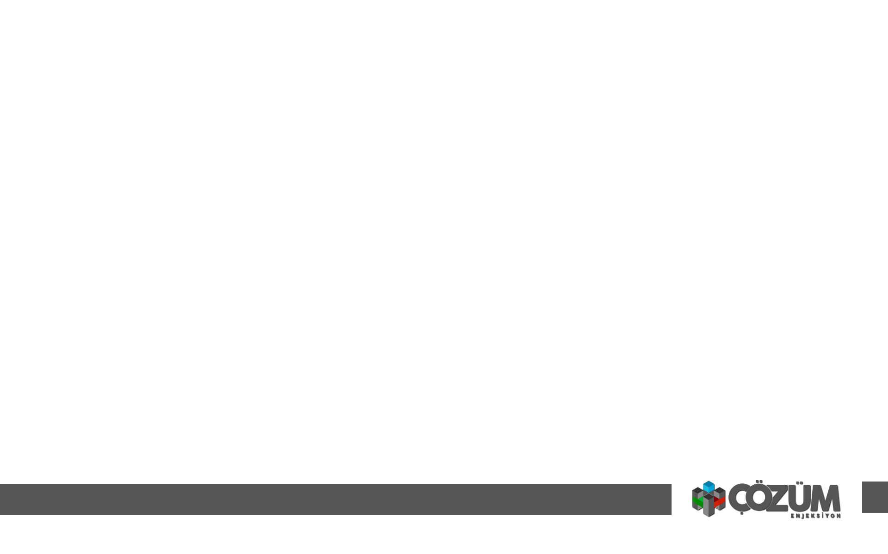
Predicted ground and surface settlement

Slide 9
Measures in Tunnel

Slide 11
Procedure
for
Foot Injection of PFV-L and PFV-S Tunnels
in Sirkeci Station
by
Taisei - Gama - Nurol Joint Venture
MARMARAY PROJECT- Contract BC1

Slide 12
1. PURPOSE OF THE WORK
In Sirkeci underground station; there are many types of tunnel section, so as Platform Tunnel (PF), Platform Ventilation Tunnel (PFV-L and PFV-S),
Center Walkway (CE), Connection Tunnel (CN) and so on. Among these sections, Platform Ventilation Tunnel (PFV-L and PFV-S) have the largest section as of 190 m².
So excavation methods for these tunnels are planned as multi bench cut method, consisting of top heading, medium bench, lower bench and invert. It is very important to
prevent settlement of top heading when bench part is excavated. The purpose of injection for foot part of top heading is to improve the ground condition of that area and prevent
settlement of top heading at the stage of bench excavation. Figure 1 and Figure 2 show sectional and plan view of injection area respectively.
Figure 1: Sectional view of injection area

Slide 13
Figure 2: Plan view of injection area
Chemical resin injection with high pressure from the Pilot Tunnel shall be applied to improve the ground condition.

Slide 14
2. PROCEDURE
The general procedure of injection is as follows.
Site Preparation
Demobilization
Mobilization
Drilling
Injection
Drilling
Injection

Slide 15
3. METHOD OF WORK
3.1. DRİLLİNG
The drilling machine with crawler base, driven by pneumatic or electric-hydraulic power, is utilized for drilling from the inside of Pilot tunnel. Drilling diameter is
45-65mm and rod length is 1.5-3m. Drilling length is about 5m and drilling angles is horizontally to slight inclined. Figure 3 shows the drilling condition in the Pilot tunnel.
Figure.3: Drilling condition

Slide 16

INJECTİON
After drilling, inflatable rubber packer shall be installed at the objective area.
To prevent leakage of injection with high pressure, proper distance of cover rock shall be kept. For this purpose, packer shall not be installed
at the portal of bored hole (it means, not close to wall of Pilot tunnel). Packer installation is shown in figure 4 and sample of packer is shown in Figure 5.
Figure 5: Sample of packer
Figure 4: Packer installation

Slide 17
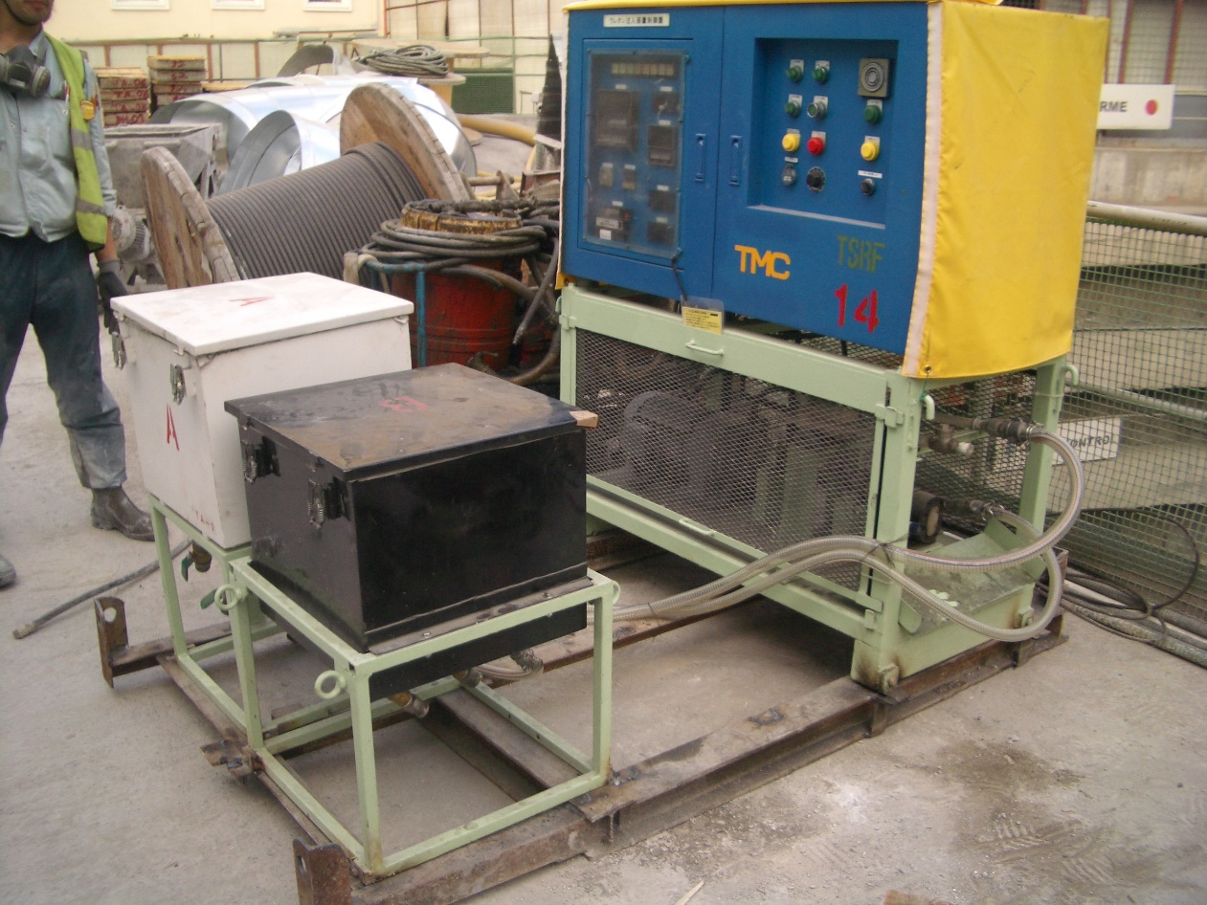
After installation of packer, chemical resin is injected by high pressure pomp.
Type A and type B of resin are injected separately by pomp and it starts chemical reaction after injection into rock. Pressure of injection shall be planned as 8-20 bar according to ground condition and potential crack inside rock which will cause leakage of injection.
Figure 6: Injection
Figure 7: Injection Pomp

Slide 18
Surface settlement precaution

Slide 20
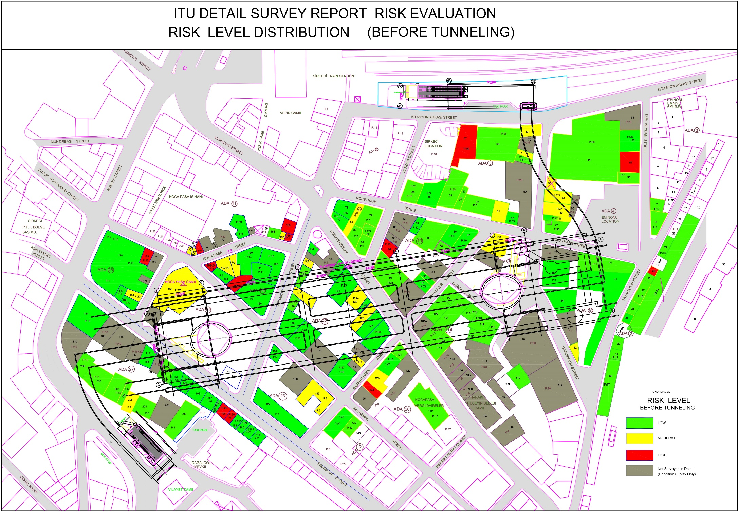

Slide 21
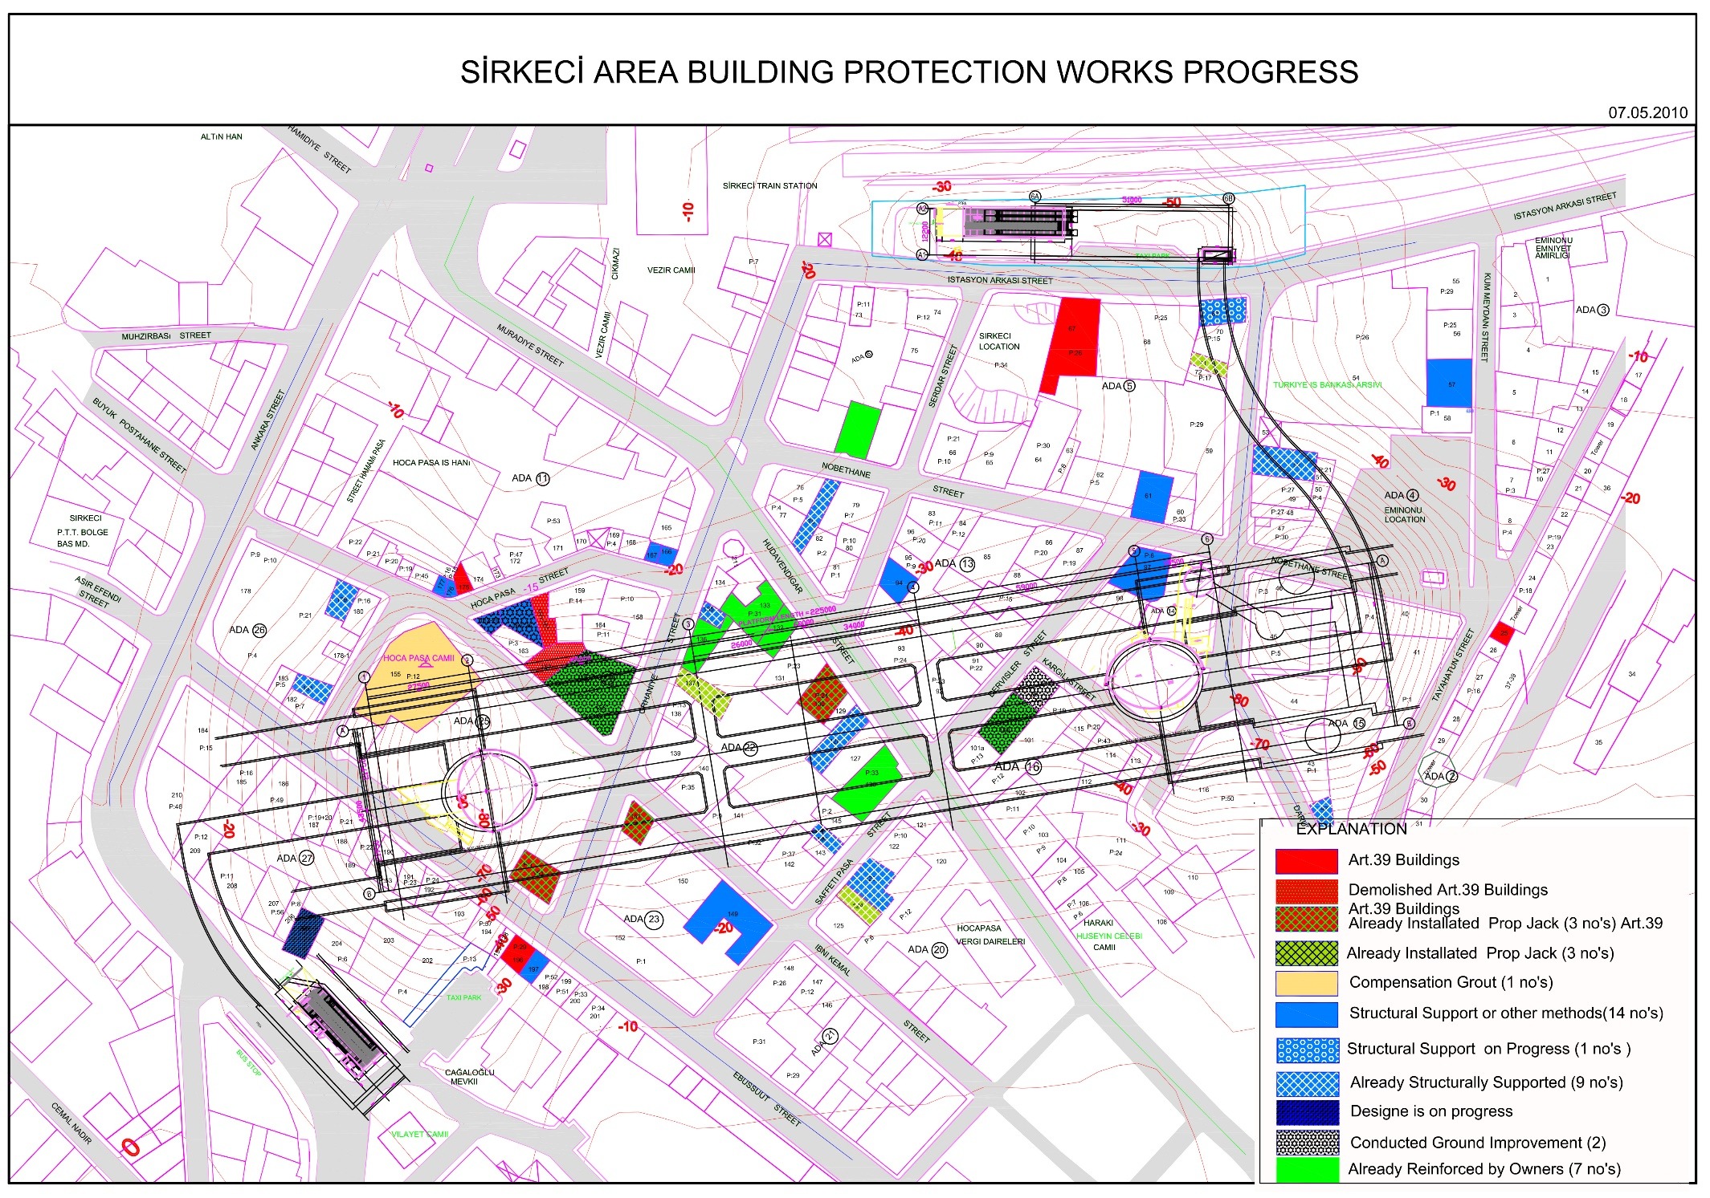

Slide 22
Procedure
for
Ground Improvement
Around East Shaft Area
Building SIR.99
(NATM Tunnel Alignment in Sirkeci)
by
Taisei - Gama - Nurol Joint Venture
MARMARAY PROJECT- Contract BC1

Slide 23
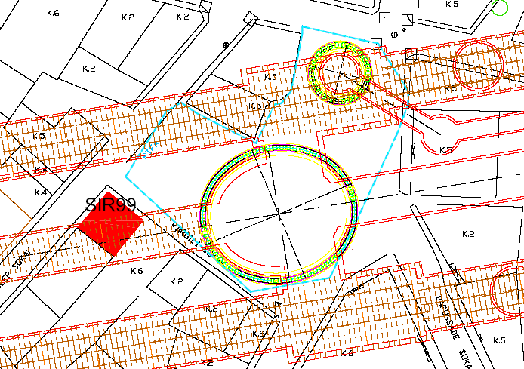
PURPOSE OF THE WORK
The purpose of injection is to improve the ground condition near vicinity of East
shaft area from the basement floor and ground floor of Building SIR 99.
Consideration has been given to this building that is located
Recently around 90 mm ground settlement near vicinity
Very close to the East shaft that will be excavated in the future
Just above the horizontal tunnel that will be excavated
Possible to conduct drilling and injection activities
In this scope, vertical bore hole drilling will be conducted from the basement floor and ground
floor of the building and cement grout will be injected step by step from the drilled bore holes.
Cement grout Injection shall be applied to improve the ground condition.
East Shaft
Figure 1: Location of building SIR99

Slide 24
PROCEDURE
The general procedure of grout injection is as follows.
Mobilization
Drilling
Injection
Repeat drilling and injection
Demobilization

Slide 25
Method of Work
Protection of the Utilities
Prior the injection work, surrounding of building will be inspected and existing utilities will be detected. Up most care will be taken for the existing utilities In order to not damage and disturb the existing utilities.
Injection levels will be decided according to detected utilities. During the injection activity one person will monitor the surrounding buildings. In case of any observation of disturbance, injection works will be stopped and recovery works will be conducted.
Drilling and injection
The electrical borehole drilling machine is utilized for vertical drilling from the basement floor of the building. The machine will be dismantled for mobilization and re-assemble at the floor of the building.
The grout injection is planned to apply between the basement and base rock mass which the objective ground like man made fill and the sandy layer under building SIR99.
One side of building SIR99 has basement floor and another side doesn’t have basement floor (Only ground floor). Therefore Injection work will be conducted from 2 floor levels.
From ground floor: Drilling length will be around 23 m
From basement floor: Drilling length will be around 20 m
Diameter of drilling will be 76 mm including casing tube.
Drilling pattern will be followed as per shown on figure 2, 3. Total 27 numbers of bore holes will be drilled.

Slide 26
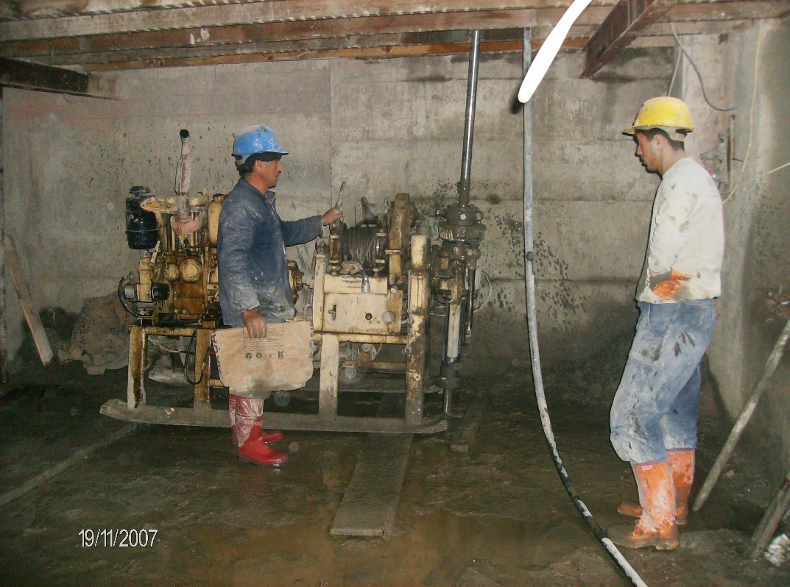
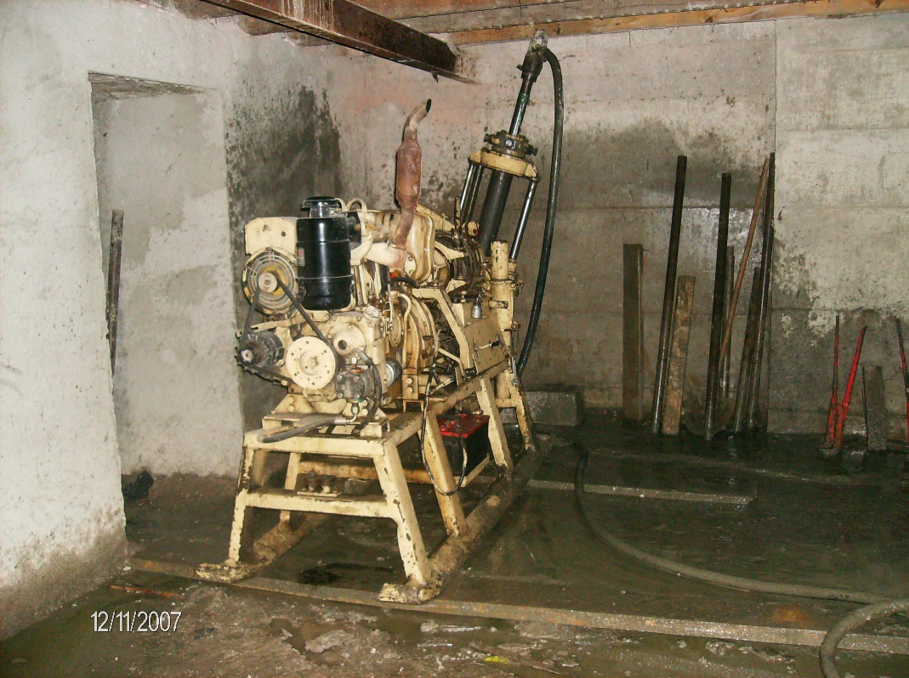
Photo 1: Drilling Machine

Slide 27
Figure 2: Drilling and Injection Plan

Slide 28
Figure 3: Drilling and Injection Plan (Detailed Plan View)

Slide 29
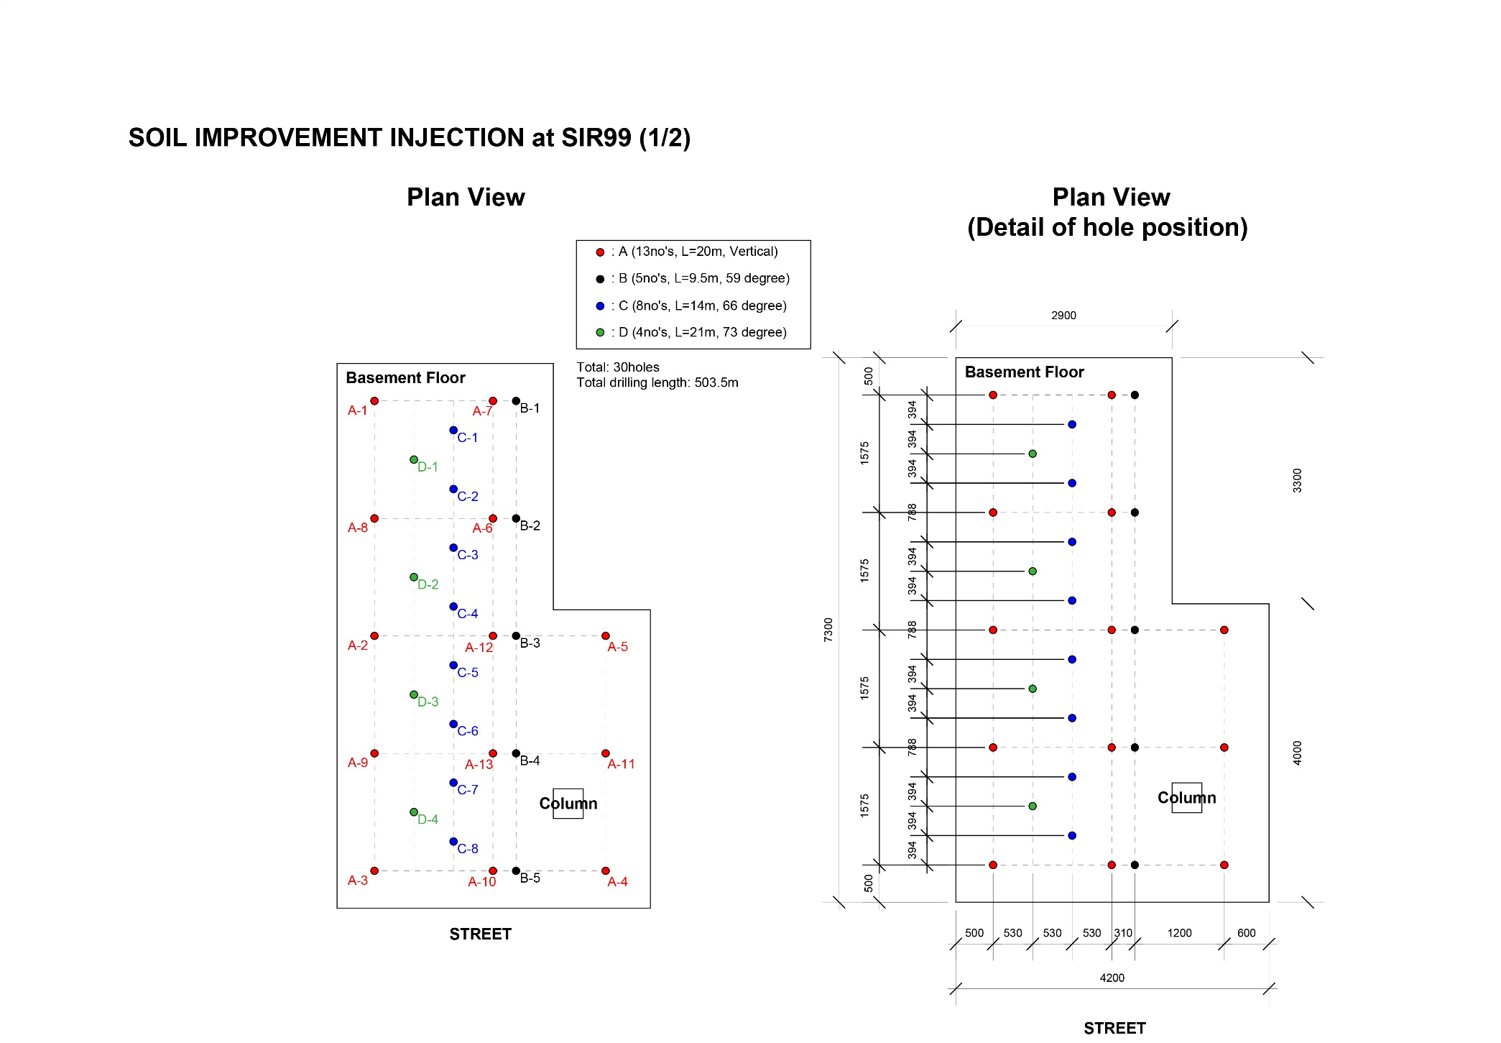

Slide 30
